Slide 1

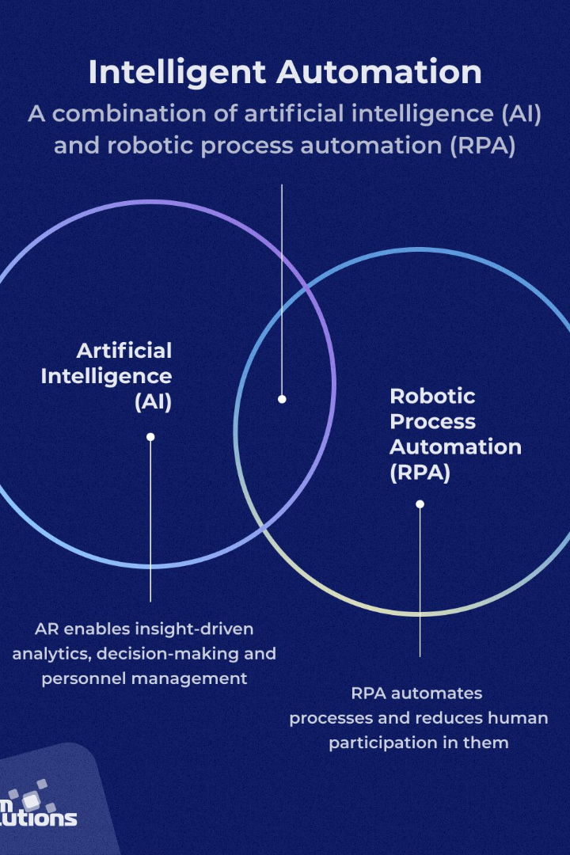
AI-Powered Business Process Automation Application
Discover the future of business automation with our AI-powered application. Streamline your processes, increase efficiency, and unlock new opportunities for growth.

Slide 2
GIT HUB REPOSITORY FOR THIS PROJECT:
https://github.com/ShanmugiEsakki/-AI-powered-Business-Process-Automation-BPA-application-.git

Slide 3

Overview of Business Process Automation (BPA) and Challenges Faced by Organizations
Business Process Automation (BPA) represents a transformative approach for organizations to streamline and optimize their workflows by automating repetitive tasks and integrating various processes. The adoption of BPA is driven by the need for increased efficiency, cost reduction, and enhanced agility. However, organizations often encounter challenges in implementing BPA solutions, such as the complexity of existing processes, resistance to change, and the inability to adapt to evolving business requirements.

Slide 4

Objectives:
Increase Efficiency: Streamline and automate routine tasks to enhance overall process efficiency.
Adaptive Automation: Create workflows that dynamically adapt to changes in business processes, ensuring agility and responsiveness.
Data-Driven Decision-Making: Utilize AI to analyze real-time and historical data, providing valuable insights for strategic decision-making.
Human-in-the-Loop Integration: Facilitate seamless collaboration between automated processes and human decision-makers, particularly in handling complex scenarios.
Scalability: Develop a scalable architecture capable of accommodating an increasing volume of processes and transactions.

Slide 5

II. Business Problem
A. Identification of a Real Business Problem Faced by Appian Customers
One common challenge faced by Appian customers is the complexity of managing and optimizing intricate business processes. Organizations often grapple with the need to balance automation with adaptability, leading to inefficiencies, increased operational costs, and a lack of agility in responding to market dynamics.
B. Importance of AI in Addressing the Chosen Business Problem
Artificial Intelligence plays a pivotal role in addressing the identified business problem. Through advanced algorithms and machine learning models, the AI-Powered BPA application can intelligently automate processes, dynamically adjust workflows, and provide data-driven insights, thus tackling the challenges of complexity and adaptability head-on.

Slide 6

III. Application Features and Functionality
A. Increased Efficiency
Automation of Routine Tasks
Intelligent Decision Support Mechanisms
B. Adaptive Automation
Dynamic Workflow Configuration
Real-Time Adaptability to Changing Business Processes
C. Data-Driven Decision-Making
Real-Time Data Analysis
Historical Data Insights for Strategic Decision-Making
D. Human-in-the-Loop Integration
Seamless Collaboration Interface
Integration with Human Decision-Makers for Complex Scenarios

Slide 7



Use Cases and Applications
Retail Industry
Healthcare Sector
Manufacturing Processes
Transform retail operations with AI-powered automation, from inventory management to personalized customer experiences.
Improve healthcare delivery, optimize patient care, and enhance medical diagnoses and treatment plans.
Optimize manufacturing operations, reduce errors, and increase productivity with intelligent automation solutions.

Slide 8
Key Features of the Application
Intelligent Workflow Optimization
Intuitive User Interface
Efficiently streamline and optimize your workflows with advanced AI algorithms that adapt to your business needs.
Experience a user-friendly interface designed for seamless navigation and easy integration into existing systems.
Real-time Analytics
Advanced Machine Learning
Gain valuable insights and make data-driven decisions through real-time analytics and customizable reporting.
Utilize cutting-edge machine learning capabilities to automate complex tasks and enhance operational efficiency.

Slide 9

Technical Architecture
User Interface (UI): An intuitive and user-friendly interface for configuring workflows, monitoring processes, and collaborating with the system.
Workflow Engine: The core engine responsible for orchestrating and executing automated workflows based on predefined rules and adaptability algorithms.
AI Module: Incorporation of AI models and algorithms for data analysis, decision support, and adaptive learning.
Integration Layer: Seamless integration with Appian's AI Process Platform and other external systems, ensuring interoperability and data exchange.

Slide 10
Implementation Steps
A. Project Kickoff and Planning
B. Data Collection and Analysis
C. AI Model Development and Integration
D. Application Development and Testing
E. Human-in-the-Loop Integration F. Scalability Testing and Optimization

Slide 11
Expected Outcomes
A. Measurable Improvements in Business Process Efficiency
B. Enhanced Agility in Responding to Organizational Changes
C. Data-Driven Insights Leading to Strategic Decision-Making
D. Seamless Collaboration Between Automated Processes and Human Decision-Makers E. Demonstrated Scalability with Increased Volume of Processes

Slide 12

Integration and Implementation
1
Seamless Integration
Easily integrate the AI-powered automation application into your existing systems and workflows without disruptions.
2
Customization Options
Customize the application to align with your specific business requirements, ensuring a tailored experience.
3
Training and Support
Receive comprehensive training and dedicated support to ensure a successful implementation and adoption process.

Slide 13
Security and Privacy
1
Data Encryption
2
Compliance Standards
3
Ongoing Monitoring
Strict data encryption protocols safeguard sensitive information throughout the automation process.
Continuous monitoring and proactive measures ensure ongoing protection against potential cybersecurity threats.
Adhere to industry-specific regulations and standards to maintain data security and privacy compliance.

Slide 14

ROI and Cost Savings
Maximized Efficiency
Enhanced Productivity
Realize significant time and cost savings by automating repetitive and manual tasks, freeing up resources for strategic initiatives.
Increase employee productivity and job satisfaction by enabling them to focus on higher-value tasks that require human expertise.
Improved Accuracy
Reduce errors and minimize operational risks by leveraging AI-driven automation built on sophisticated algorithms and machine learning.

Slide 15
Conclusion and Next Steps
Recap the key features, benefits, and applications of the AI-powered business process automation application. Explore next steps for organizations ready to embark on this transformative journey.

